Slide 1
MINI PROJECT
Submitted to : Ms.Gurpreet Kaur
( TECHNICAL TRAINER)

Slide 2
Team Members
NAME | UNIVERSITY ROLL NO.
MANU PACHAURI | 201500387
TANISHQ GUPTA | 201500736

Slide 3
Content
Introduction Of Website
Technologies used
HTML
CSS
JAVASCRIPT
Code Samples
Code Link
Website Samples
Website Link

Slide 4
Introduction Of Website

Slide 5
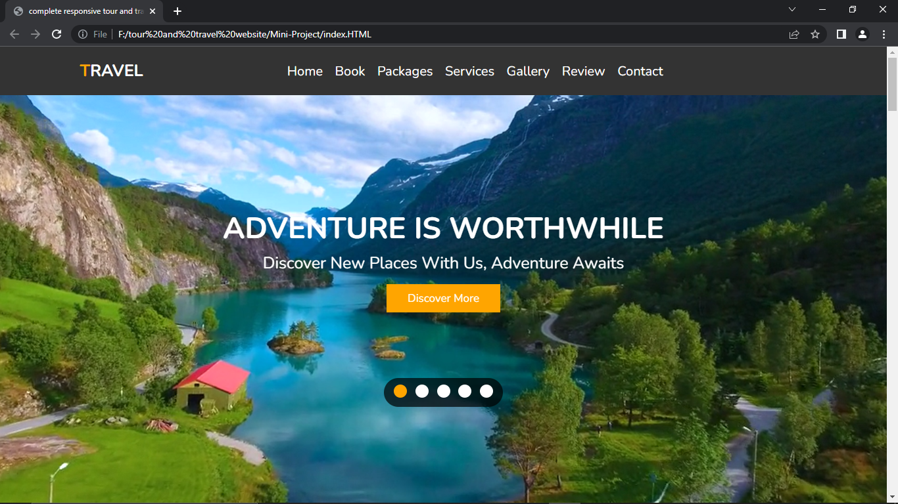
Introduction Of Website
Websites come in a nearly endless variety, including educational sites, news sites, forums, social media sites, e-commerce sites, and so on.
This is a responsive Tour and Travel Website for Booking National, Inter National Trips.
The homepage represents the main page of the site itself. This Website is hosted on GitHub servers, and require a web browser such as Chrome, Firefox, or Internet Explorer to be visited

Slide 6
Technologies Used

Slide 7

HTML5

Slide 8

HTML5 (Hyper Text Markup Language)
HTML is the standard markup language for Web pages.
HTML is an abbreviation of Hypertext and Markup language. Hypertext defines the link between the web pages.
HTML 5 is the fifth and current version of HTML. It has improved the markup available for documents and has introduced application programming interfaces(API) and Document Object Model(DOM).
Easy DOCTYPE declaration i.e. <!doctype html>

Slide 9
CSS3

Slide 10

CSS 3(Cascading Style Sheets)
CSS is the language we use to style an HTML document.
CSS describes how elements should be rendered on screen, on paper, in speech, or on other media.
If you are using CSS, you do not need to write HTML tag attributes every time. Just write one CSS rule of a tag and apply it to all the occurrences of that tag.

Slide 11
JAVASCRIPT

Slide 12

JAVASCRIPT
JavaScript is a lightweight, interpreted programming language. It is designed for creating network-related applications.
It is not only Client Side Scripting language but also Server side Scripting
JavaScript helps you to create beautiful and fast dynamic websites.
JavaScript contain of tons of libraries and frameworks which we can used directly on websites

Slide 13
Code Samples

Slide 14
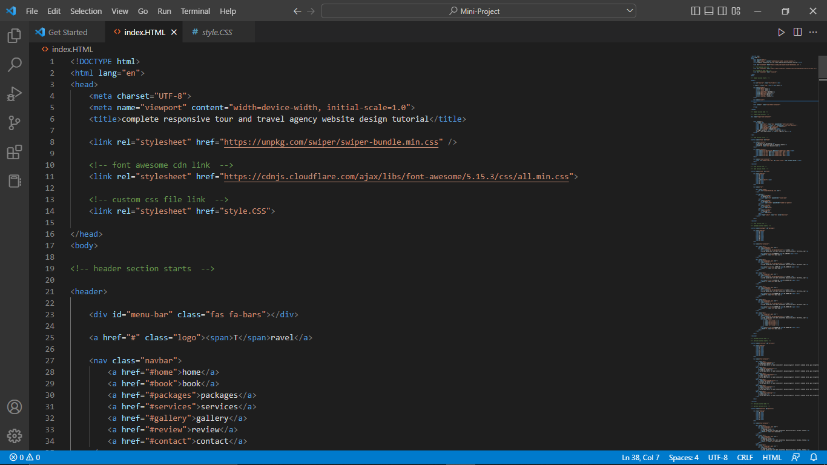
Banner Section

Slide 15
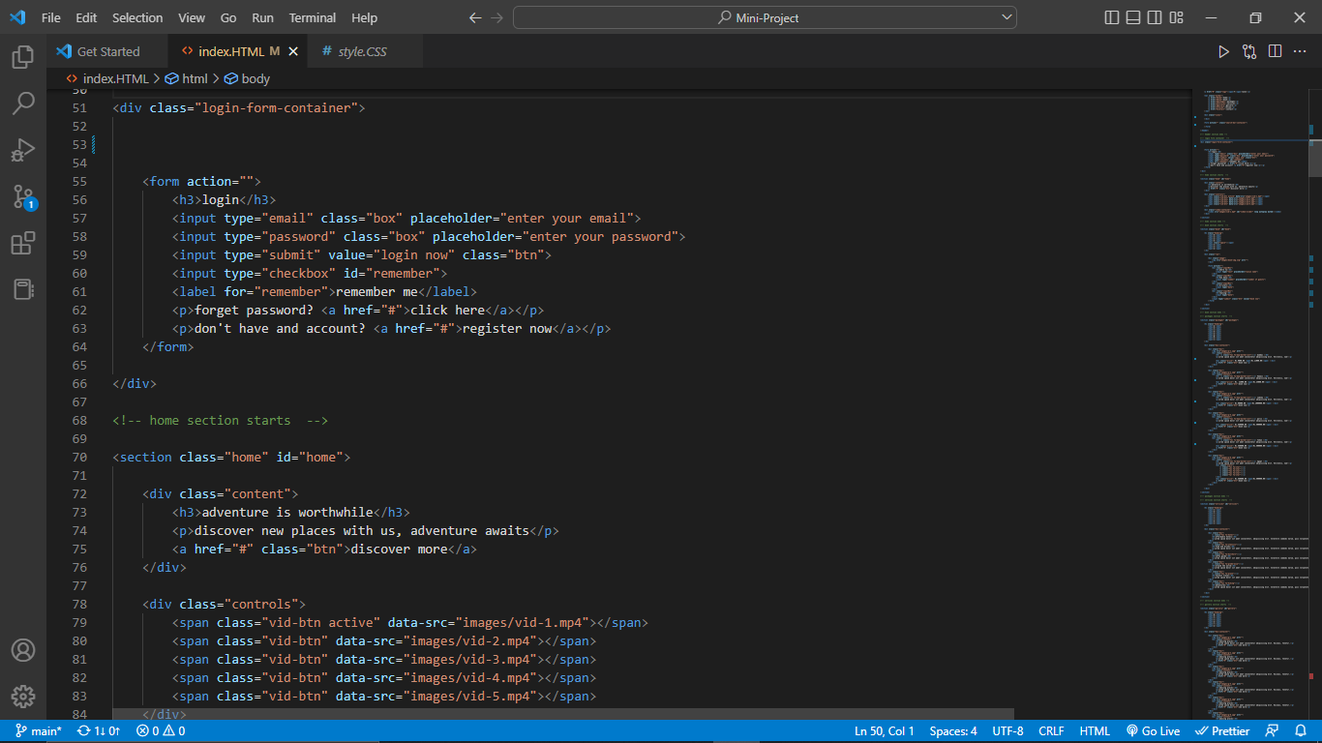
About Section

Slide 16
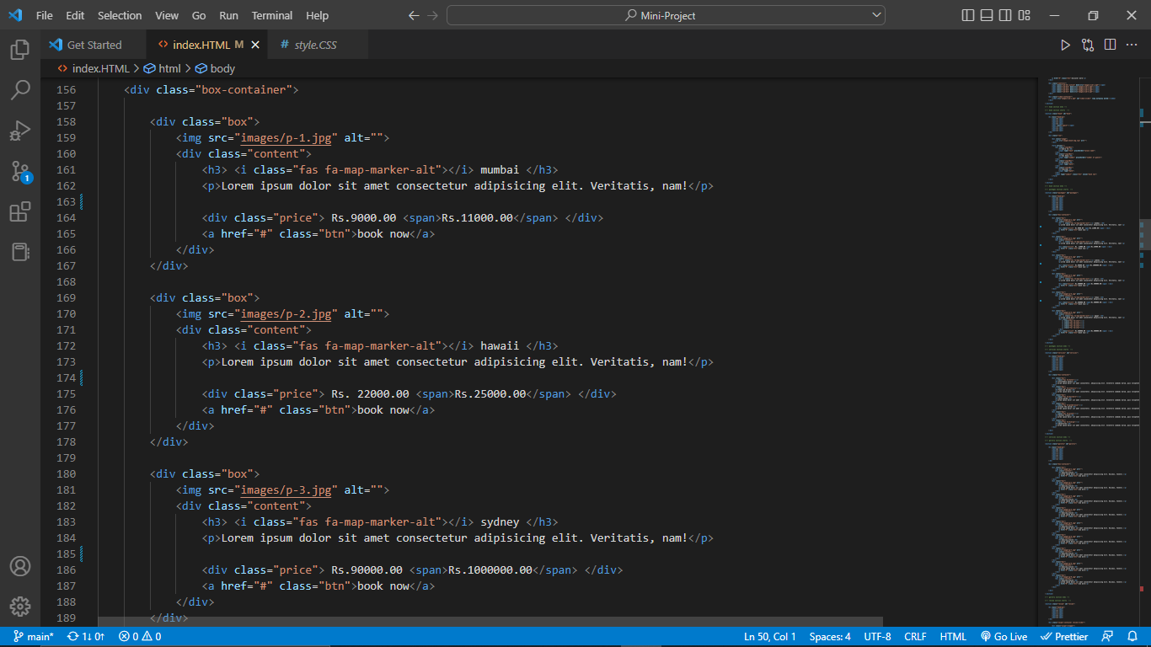
Product Section

Slide 17
Code Link

Slide 18
https://github.com/imtanishq/Mini-Project

Slide 19
Website Samples

Slide 21
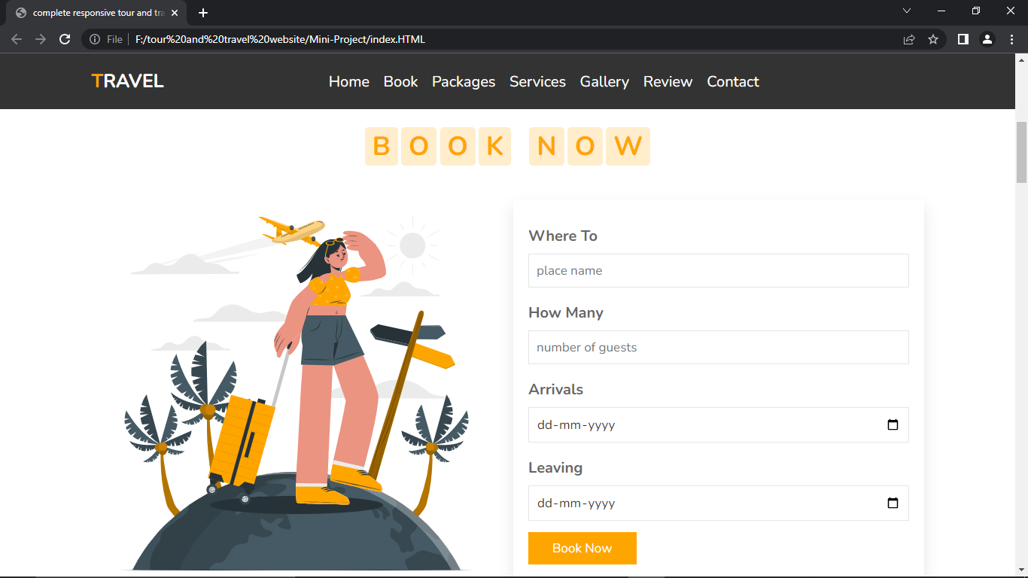

Slide 22
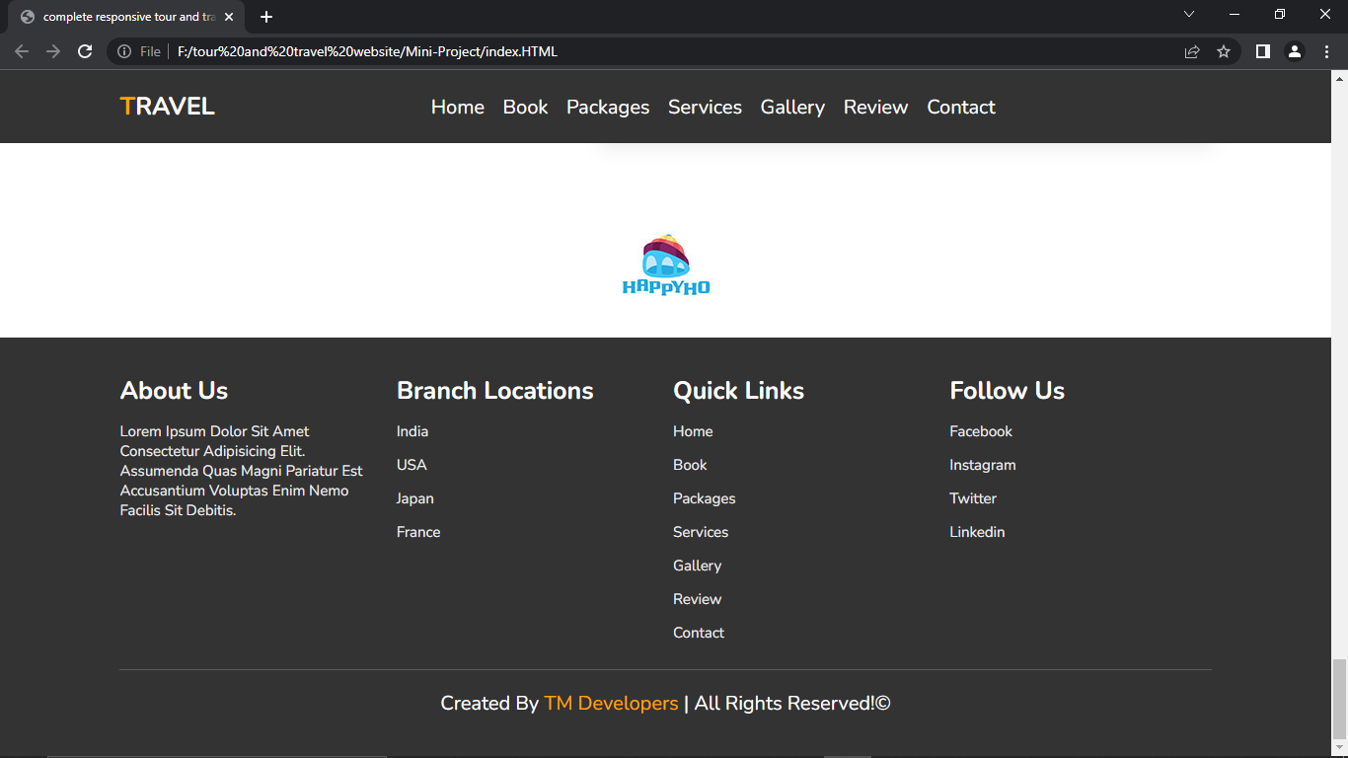

Slide 23
Website Link

Slide 24
https://imtanishq.github.io/Mini-Project/index.HTML

Slide 25
Thank You

